Slide 1
Intro to RPi (Part 3)
By SUTD IEEE

Slide 2
Agenda
RPi Serial Communication (Contd.)
Using Firebase with RPi (the right way)
Running a Web Server on the RPi

Slide 3
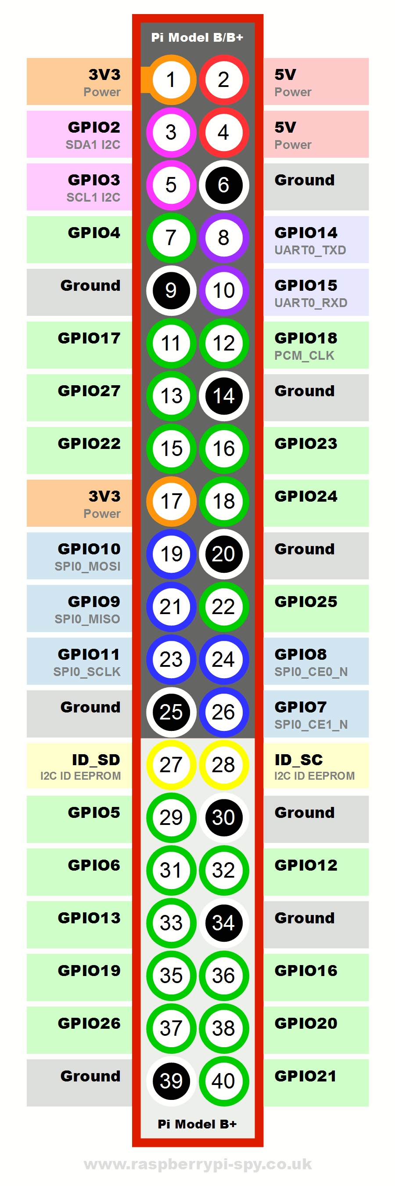
Rpi GPIO
https://pinout.xyz/#

Slide 4


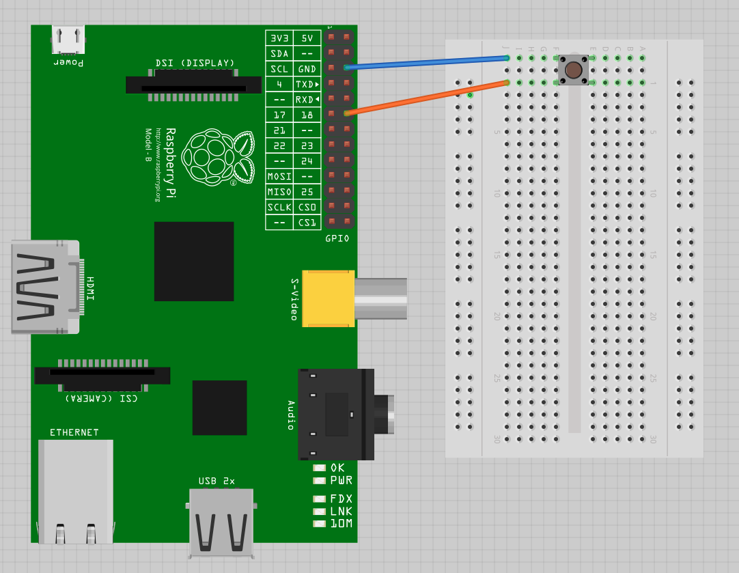
Activity: Push Button
Connect one end of the button to BCM26
Connect the other end on the same side to GND

Slide 5
Activity: Push Button
GPIO.setup(26, GPIO.IN, pull_up_down=GPIO.PUD_UP)
GPIO.input(26)

Slide 6
Activity: Push Button - Debounce
Oscillation in mechanical switch in button => Multiple button presses
Logic:
Wait for x ms after button pressed and until button is released
Only then register it as 1 button press

Slide 7
Serial Communication
Send data bit by bit, instead of all at once
Many protocols:
UART / USART
SPI
I2C
…

Slide 8
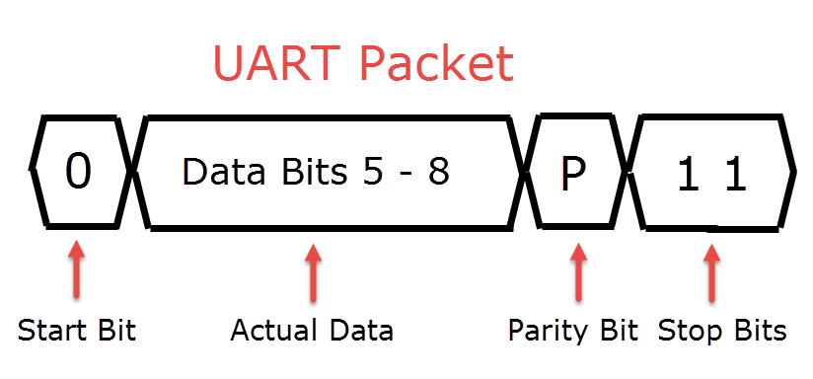
Serial Communication (UART)
Universal Asynchronous Receiver-Transmitter
Star-Bit
Data Bits
Parity Bit (Optional)
Stop Bit/s

Slide 9
Python Serial in RPI (With Arduino)
Why?
Offload processing and simple tasks to Arduino
Add more input/ output pins
Connect to other serial peripherals
How?
Connect a USB cable from the Pi to the Arduino

Slide 10
Python Serial in RPI (With Arduino)
Install pyserial
sudo pip3 install pyserial
Create a Python file
import serial
ser = serial.Serial(‘/dev/tty*’, 9600)
ser.write(‘Something’) >> ‘Something’ must be in bytes
Check serial port name:
ls /dev/tty*

Slide 11
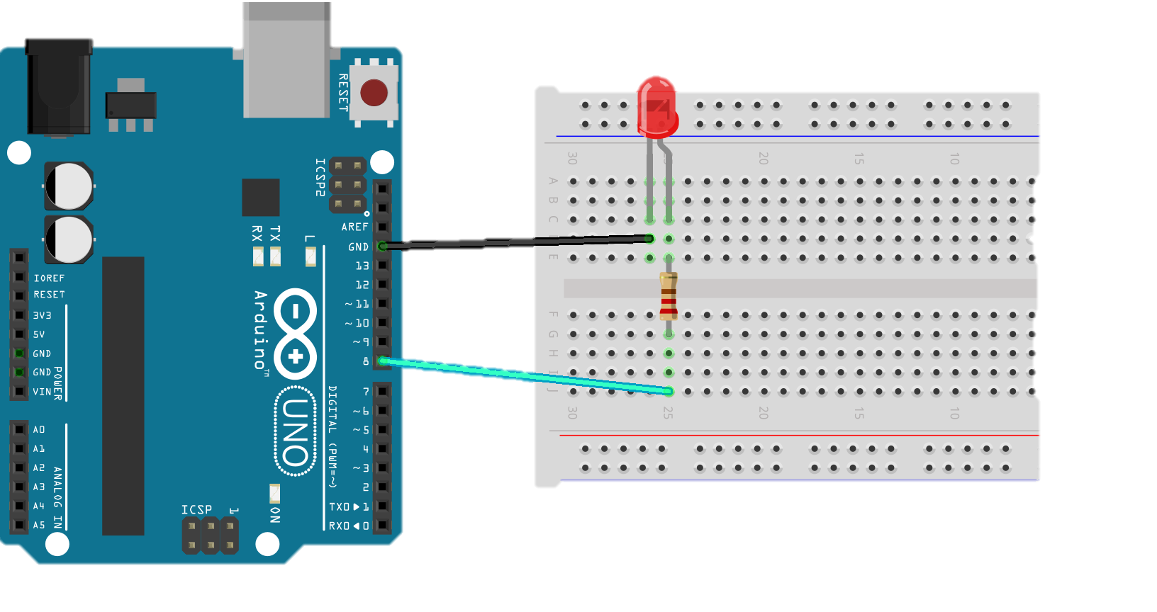
On Arduino
String inString = “”; void serialEvent() { char c = ‘ ’; c = Serial.read(); if (c != ‘\n’) { inString += c; } else { // Do Something ! inString = “”; } }

Slide 12
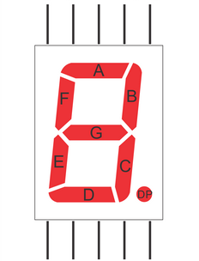
On Arduino
11
12
+5V
9
10
Seven Segment Display
Common Anode
Connect one of the ‘Com’ to +5V
Connect other pins to Arduino Digital Pins
Through RESISTORS!
8
5
7
6

Slide 13
SPI and I2C
RPi has:
3 SPI Bus’s (Only one accessible via the headers)
2 I2C Bus’s accessible through the headers
I think

Slide 14
Firebase (The Right way)
‘Database Secrets’ is deprecated
‘python-firebase’ module not updated in 4 years
The right way?
Firebase Admin SDK (Python)

Slide 15
FIREBASE (THE RIGHT WAY)
Open your Firebase Console
Navigate to Project Settings >> Service Accounts
Generate new Private Key >> Save that file in your project folder

Slide 16
FIREBASE (THE RIGHT WAY)
In the Firebase Console:
Open Database Tab
Navigate to ‘Rules’
Change it to this: { "rules": { ".read": "auth.uid === ‘some_UID’”, ".write": "auth.uid === ‘some_UID’” } }
Publish

Slide 17
Firebase (The Right way)
How to install?
sudo pip3 install firebase-admin
Create a Python file
import firebase_admin
from firebase_admin import credentials
from firebase_admin import db

Slide 18
FIREBASE (THE RIGHT WAY)
cred = credentials.Certificate(‘PATH_TO_KEY')
firebase_admin.initialize_app(cred, {
'databaseURL': 'https://your_database.firebaseio.com/',
'databaseAuthVariableOverride': {
'uid': ‘your_uid'
}
})

Slide 19
FIREBASE (THE RIGHT WAY)
To use the database:
mydatabase = db.reference()
Get:
mydatabase.get()
mydatabase.child(‘some_child’).get()
Set:
mydatabase.child(‘some_child’).set( { “key”: “value” } )
Update
Push

Slide 20
FIREBASE (THE RIGHT WAY)
Refer to the template to learn how to continuously get a certain database entry

Slide 21
Firebase (The Right Way)
Your task:
Write another file that asks for an input and updates a particular database entry using .set() -> On your computer
Run a script on the RPi to continuously read that same database entry and based on that asks the Arduino to display said input on the 7-Segment Display

Slide 22
Flask Server
Flask is a Python framework that allows you to manage your web servers
It is not a web server! (Though it comes with one by default)
Install:
virtualenv:
sudo pip3 install virtualenv
mkdir myproject
cd myproject
virtualenv myvenv
. myvenv/bin/activate
flask:
pip3 install Flask

Slide 23
Flask Server
Refer to ‘flaskapp’ in Templates for example

Slide 24
The ENd

